Slide 1
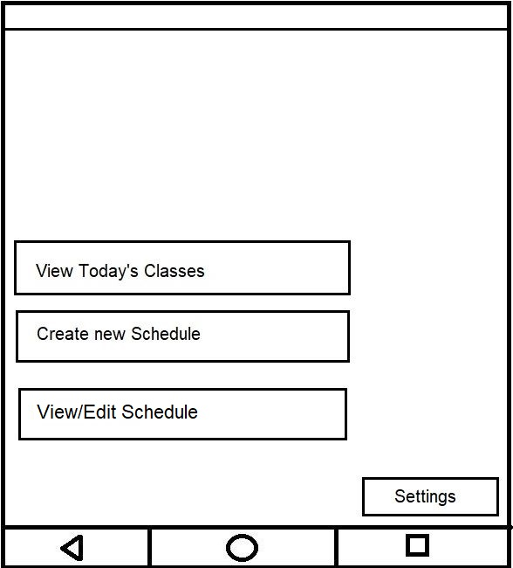
This will be the Home Screen which will pop up as soon as you enter the app (with exception of a loading screen which can be integrated in the future).
-Assuming you don’t have a schedule created yet, Create your first daily schedule.
Home screen

Slide 2
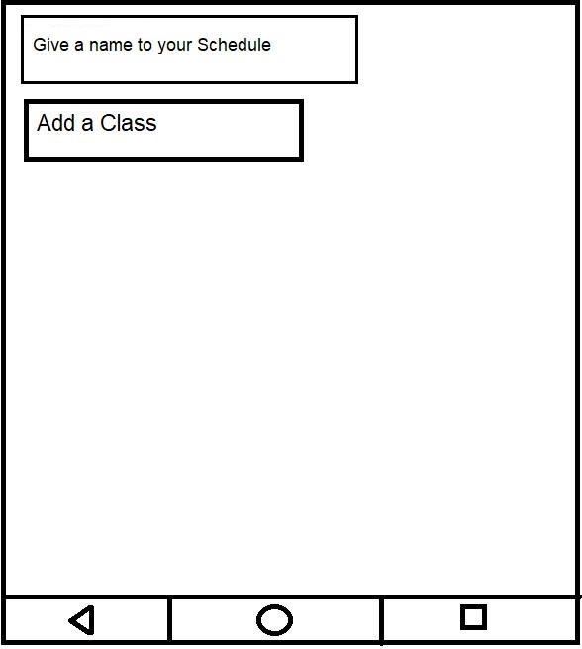
Naming your Schedule
-While on this screen, give a name to your schedule and select the the Add a Class Button to add your first class.

Slide 3
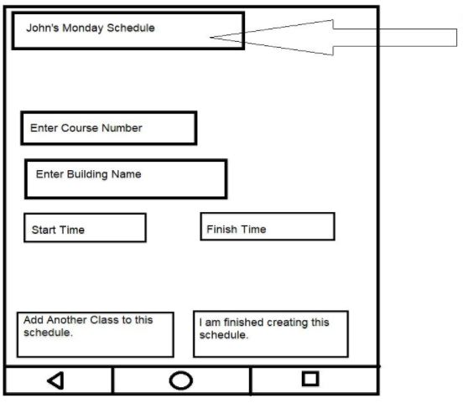
Adding a Class (continued)
Edit Schedule Name
-To create your first class, start by Entering the Course Number. Once you have entered the course number, enter the building name, start time, and end time.
-After completing adding all of your class details, either add another class to this schedule or finish creating the schedule.

Slide 4
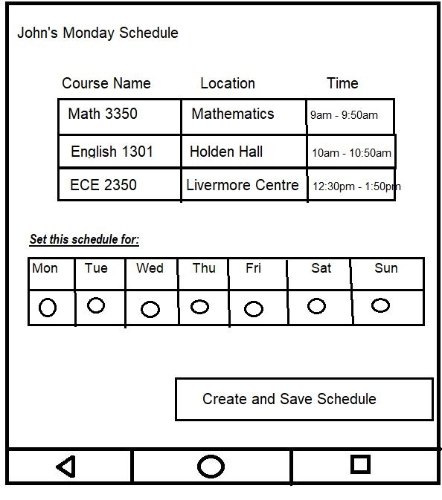
-Assume you added these 3 classes to your schedule.
- You are now able to choose the days of the week when you want it repeated.
-Enter your schedule to repeat on Monday, Wednesday, and Friday.

Slide 5
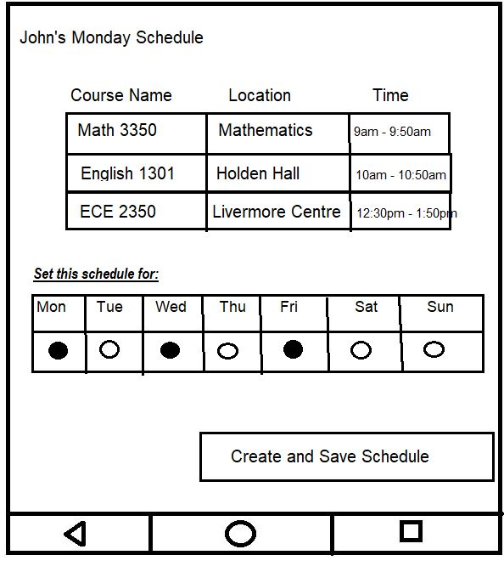
Completing creating a schedule and Saving it
-Now, assuming you selected the schedule to repeat every Mondays, Wednesdays and Fridays.
-The final step in creating the schedule will be to select the Create and Save Schedule Button.

Slide 6
-Now we are back at the home screen. Select View/Edit Schedule to view the list of your created schedules and to edit an existing schedule that you created.

Slide 7
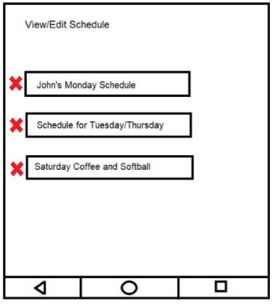
Select Schedule you would like to edit
- On this screen, you have the option to select the schedule you would like to view, edit, or delete.
-Please select John’s Monday Schedule to edit.

Slide 8
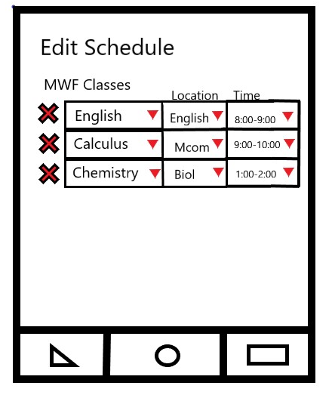
-On this screen, you can edit the Class name, Location, and Time.
-Start by clicking the Chemistry to edit the name.

Slide 9
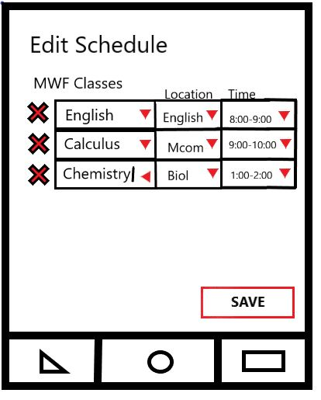
-On your actual screen, you will be able to type the new name of the class.

Slide 10
-Now, edit the Location of the chemistry class.

Slide 11
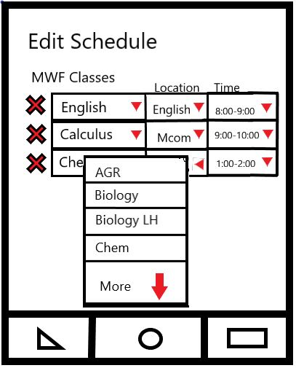
-This drop down menu will pop up, where you will be able to have the option to choose the Texas Tech buildings that your class is at.

Slide 12
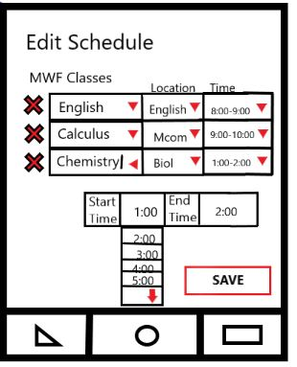
-Clicking the Time arrow will show this screen where you can change the start and end time. Then click the Save button to save the class.

Slide 13
Now that we are back at the Home Screen, click View Today’s Classes to show the entire route for the day on the map.
Home screen

Slide 14
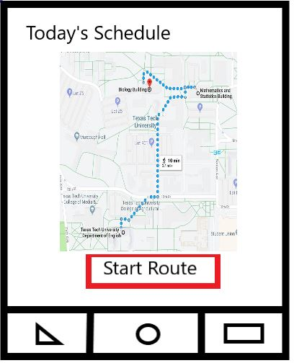
This is your entire day’s route in one map!
Click Start Route to start your first route to your first destination.

Slide 15
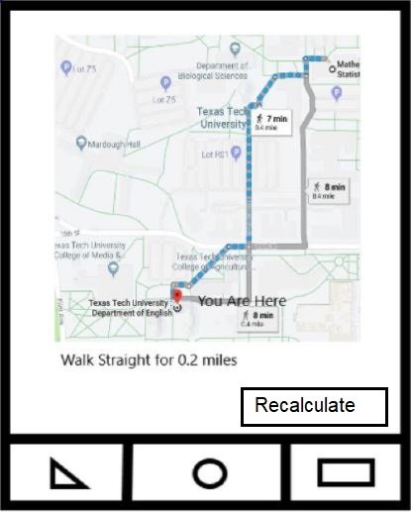
Recalculate button during Navigation

Slide 16
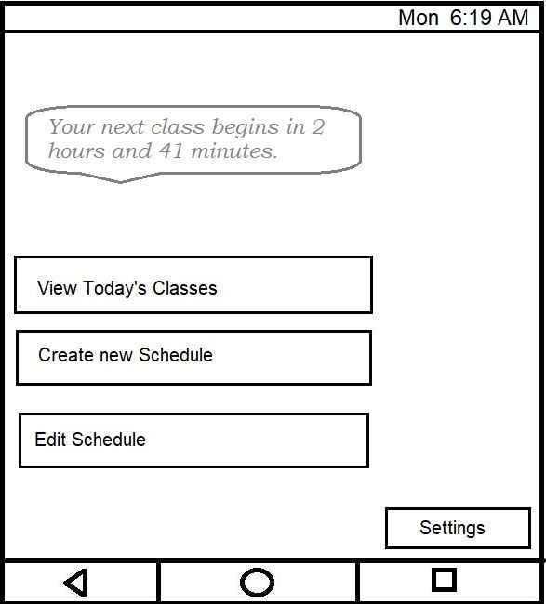
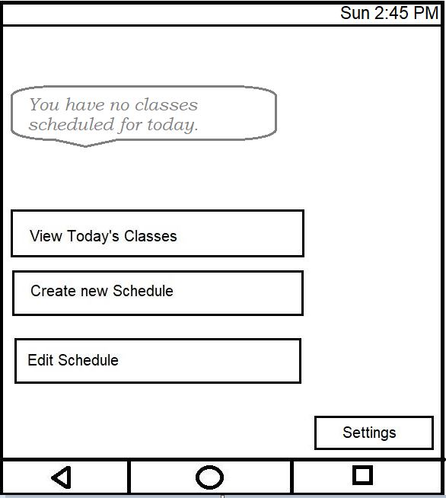
Home Screen after creating a schedule Home Screen on a day with no classes

Slide 17
Click The settings button to configure the apps settings

Slide 18
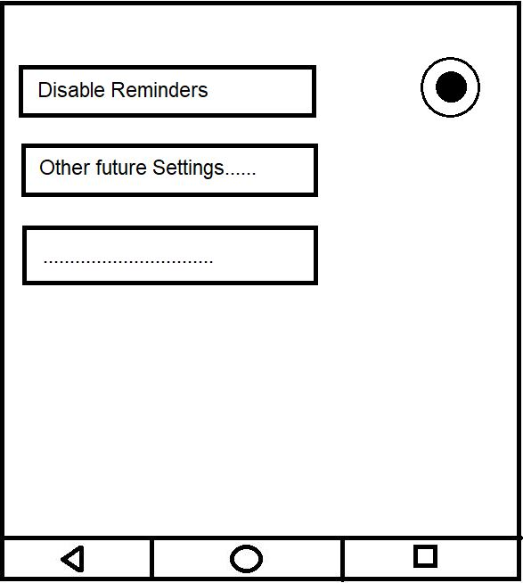
-You will be able to select the Disable Reminders button toggle in case you want the application to not disturb you with notifications.
It can be a handy feature for the holidays.
-Other Settings will be integrated in due time.
(Any suggestions for additional settings for a navigational app ??)
Settings menu (selected from Homescreen)

